Slide 1
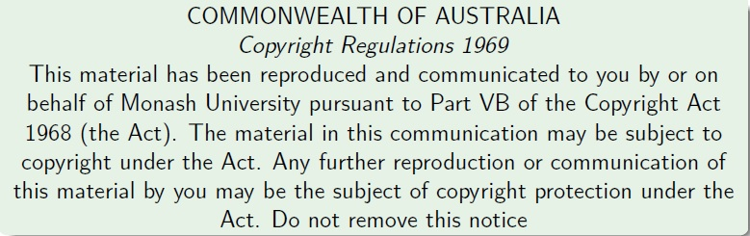
Faculty of Information Technology, Monash University

Slide 2
FIT2004: Algorithms and Data Structures
Week 1: Introduction, and Proof of Correctness
These slides are prepared by M. A. Cheema and are based on the material developed by Arun Konagurthu and Lloyd Allison.

Slide 3
Outline
Part 1: Introduction to the unit
Part 2:
Proving Correctness of Algorithms
Complexity Analysis (Recap)
Solving Recurrence Relations

Slide 4
What’s this unit about
The subject is about problem-solving with computers: algorithms and data structures.
The subject is not (mainly) about programming.
The subject just happens to use Python as the programming language in which lab work (etc.) is done. This subject is really language agnostic.
Algorithms in this courseware will be presented/describe in English, pseudo-code, procedural set of instructions, Python, or even other programming language(s), as convenient.

Slide 5
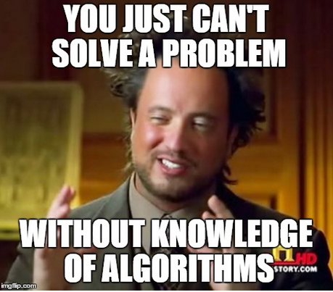
Expectations
You must take this unit seriously and work diligently.
The subject is arguably the most important for computer and technology related careers
Big companies (e.g., Google, Microsoft, Facebook etc.) actively hunt for people good at algorithms and data structures
The things you learn will help you throughout your career
Expertise in algorithms and data structures is a must if you want to do research in computer science
This unit is CHALLENGING
You have to be on top of it from week 1 – you cannot pass if you think I can cover up the material close to the assessment deadlines
Missing lectures or tutorials will require double the efforts to recover
Good News: If you work diligently, you will learn a lot and enjoy this unit

Slide 6
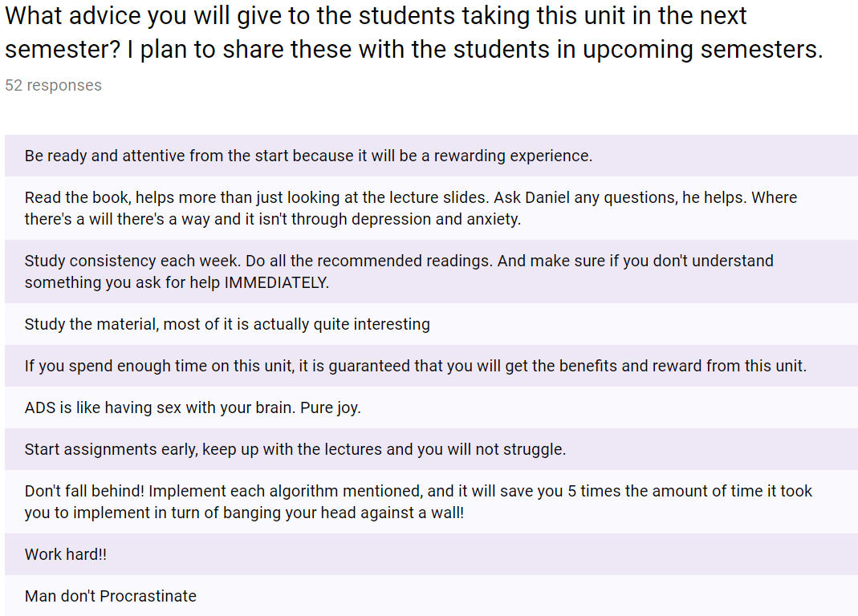
Survey conducted at the end of S1, 2018

Slide 7

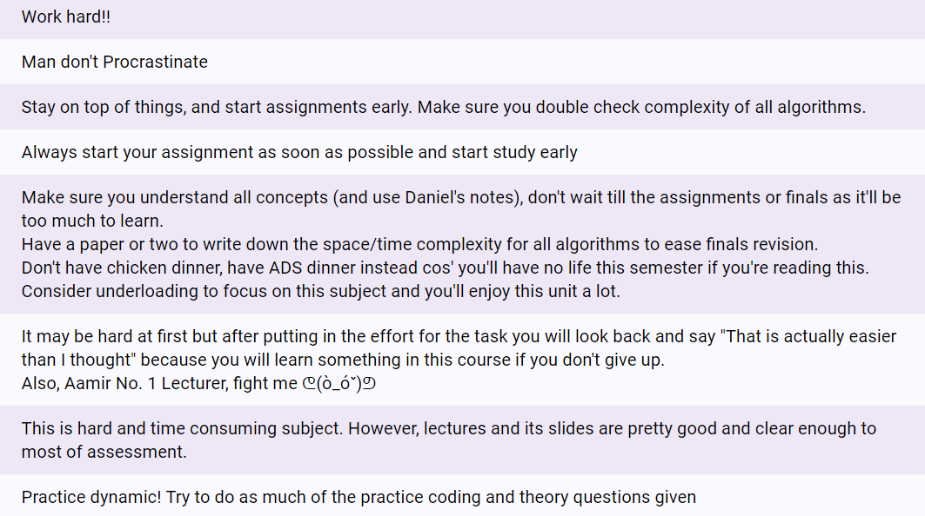
Continued…
The complete set of responses can be accessed at
https://moodle.vle.monash.edu/pluginfile.php/7194017/mod_resource/content/2/advice.pdf

Slide 8
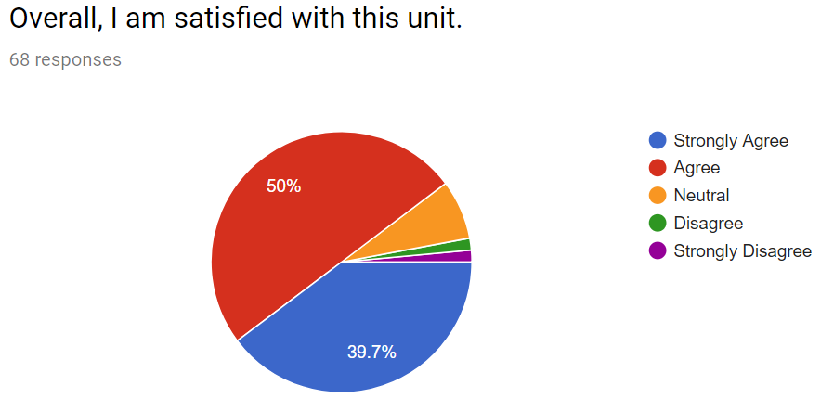

Well, this looks challenging!!! Students must have hated the unit, right?
What is the best unit you have taken so far? Why it was the best and what FIT2004 can adapt from that unit to improve?
Almost 50% respondents said FIT2004 itself was the best unit they had taken at FIT.
I believe the reason is that the students who work hard get to learn a lot of very interesting stuff and find this very rewarding.

Slide 9
Overview of the content
The unit aims to cover
General problem-solving strategies and techniques, e.g.
Useful paradigms, e.g.
dynamic programming,
divide and conquer, etc.
Analysis of algorithms and data structures, e.g.
program proof / correctness
analysis and estimation of space and time complexity, etc.
A selection of important computational problems, e.g.
sorting,
retrieval/searching, etc.
A selection of important algorithms and data structures,
as a tool kit for the working programmer,
as example solutions to problems
as examples of solved problems, to gain insight into concepts

Slide 10
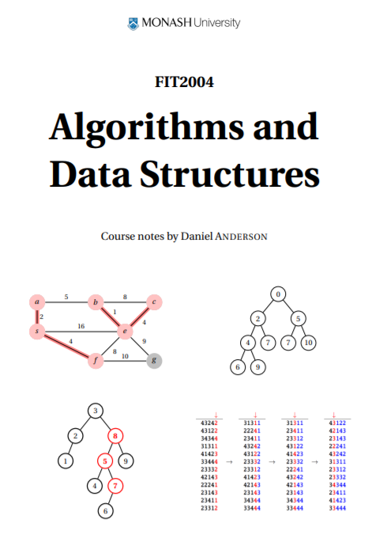
Unit Notes
Unit notes are written based on the material covered in lecture notes
Notes for all 12 weeks are available in a single PDF file on Moodle
Click on “Unit Information”
Scroll down to the bottom of the page
Click on “Lecture Notes – written by Daniel Anderson”

Slide 11
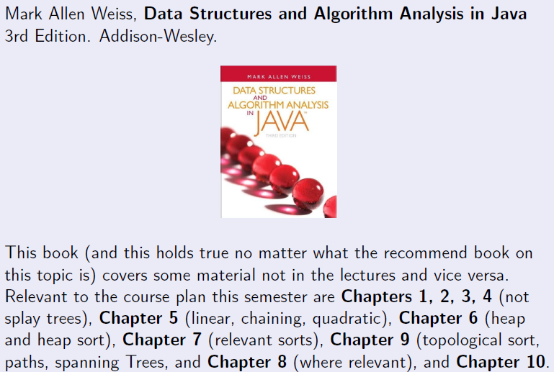
Textbook reference

Slide 12
Recommended Books
This subject has immense practical value for your development into professional programmers, technicians, software engineers, computer scientists, etc. Therefore, you should read beyond what is prescribed for this unit.
Additional books you might want to refer to (from time-to-time, even beyond this unit):
Thomas H. Cormen, Charles E. Leiserson, Ronald L. Rivest, Cliord Stein. Introduction to Algorithms. 3rd Edition. The MIT Press & Mc Graw Hill.
Donald Knuth, The Art of Computer Programming, Pearson. (Pretty expensive, but good-value-for-money for serious programmers; library has copies!)

Slide 13
FIT2004 Staff
Chief examiner and unit lecturer: Assoc Prof Dr. Gholamreza Haffari
Other unit lecturer: Dr. Davoud Mougouei
Malaysia unit lecturer: Dr. Wern Han Lim
Tutors:
Mohammad Shamsur Rahman
Nathan Companez
Chaluka Salgado
Zhou Shao
Kiana Zeighami
Saman Ahmadi
Tharindu Warnakula
Vishwajeet Kumar

Slide 14

Course Material
Your main portal will be, as you already know, the unit's Moodle page: http://moodle.vle.monash.edu/
Material available on Moodle will include:
Lecture slides
Lecture recordings
Unit Notes
Tutorial sheets
Remember(!) to keep following the forum posts

Slide 15

Course Structure
Lecture 2hrs (Thursday 14:00 to 16:00, CL_21COL/E1)
Live Streaming!
All classes start at :00 and finish at :50
Tutorial 3hrs (see allocate+)
No tutorial in week 01
Bad timetable??? I tried my best to move classes around but timetabling is beyond my control!

Slide 16
MARS: Monash Audience Response System
Visit http://mars.mu on your internet enabled device
Log in using your Authcate details (not required if you’re already logged in to Monash)
Touch the + symbol
Enter the code for your unit: 58W65J
Answer questions when they pop up

Slide 17
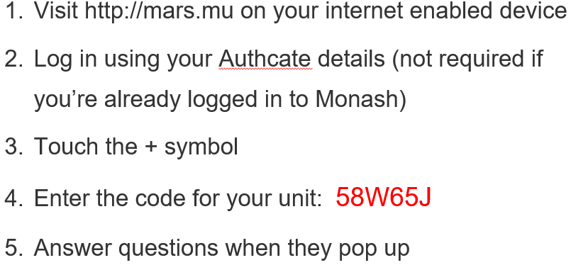
MARS: Multiple Choice Questions
When did you take FIT1045?
S1, 2016
S2, 2016
S1, 2017
S2, 2017
S1, 2018
I didn’t do FIT1045

Slide 18
MARS: Text-based questions
Where do you live? (write the name of the suburb)
Visit http://mars.mu on your internet enabled device
Log in using your authcate details
Touch the + symbol
Enter the code for your unit: 58W65J
Answer questions when they pop up

Slide 19
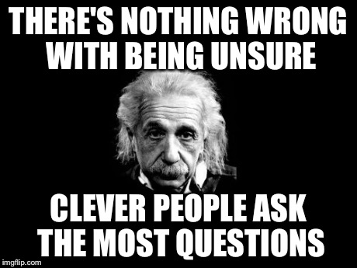
Asking Questions During Lectures
Traditional way (preferred)
Say it!
Ask online
Go to a link that I will show on slides
Write your questions
Explain your question clearly
And/or upvote/downvote already posted questions
You can post question anonymously
Do not misuse the system: We can look at the logs to identify users if required

Slide 20
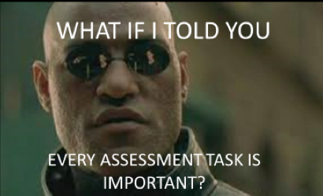
Assessment Summary
Prac assignments 1-4 (week 4, 6, 10 and 12) 30%
Tutorial participation 10%
Final Exam 60%

Slide 21
Prac Assignments 1-4 (23%)
Four practical assignments (each worth 7.5%)
Due: Week 4, 6, 10, 12
Focus is on implementing algorithms satisfying certain complexity requirements
Must be implemented in Python
Start early!!!

Slide 22
Mid-Semester Test (10%)
In week 8
Monday, 10 September 2018 (location&time: TBD)
Mark the date (and possible times) in your calendar and make sure you’re available
Covers the content taught in first 6 weeks
Duration 40-50 minutes
Style similar to final exam

Slide 23

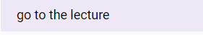
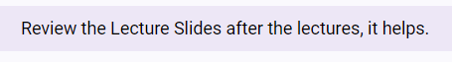
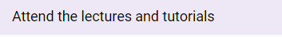
Lecture Participation (5%)
Starts from week 2
Each lecture worth 0.5%
We have 11 lectures (so total capped at 5%)
Active participation is assessed using your responses to MARS questions
You don’t have to give correct answers.
As long as you attempt MARS questions in the lectures, you will be considered actively participating.
Can be done via live streaming

Slide 24
Attending Lectures via Live Streaming
Physical attendance is highly recommended
There may be a delay of up to 30 seconds
DO NOT ASK QUESTIONS USING PANOPTO (not monitored)
Use Google Slide Q&A feature shown earlier
Need to answer MARS questions throughout the lecture (missing one or two is fine) but if you answer questions only at the beginning or end of the lecture, you may lose marks
We will access live streaming record to see how much of the lecture you watched via live streaming
Don’t just drop-in/drop-out halfway through
It is your responsibility to make sure you are able to participate via live streaming
Poor internet connection, crashed computer etc. are not accepted as valid reasons for special consideration

Slide 25
Tutorial Participation (10%)
We have 3 hrs weekly tutorials starting from week 2
Tutorial sheet for week 1 is uploaded and you are expected to complete it at your own time
Each tutorial is worth 1 marks . There are 11 weeks. So that best 10 tutorials will be counted. (total marks capped at 10).
In each lab/tutorial:
Hurdle: (no marks awarded if hurdle not met)
You must answer questions in the section (assessed preparation) in your Tutorial sheet before the class starts (give your tutors your solutions at the start of the class)
Active participation:
Actively engaging in discussing the tutorials in-class
1 marks awarded if hurdle met and actively participated

Slide 26

Final Exam (60%)
2 hours + 10 minutes reading time

Slide 27
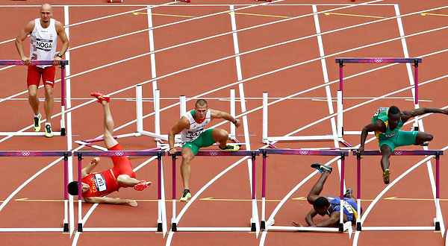
Hurdles
To pass this unit a student must obtain:
40% or more in the unit’s final exam (i.e., at least 24 out of 60 marks for final exam), and
40% or more in the unit's total non-examination assessment (i.e., at least 16 out of total 40 marks for in-semester assessments), and
an overall unit mark of 50% or more.
If a student does not pass these hurdles then a mark of no greater than 49N will be recorded for the unit.
He is the worst of all. Didn’t even try.
don’t be that guy
(or that one)

Slide 28
Submission of Assignments
Submission details will be specified on each assignment/laboratory sheet
You will submit your assignments to Moodle.
Whenever you submit an assignment you must complete an assignment submission form.
Late submission will have 20% off the total assignment marks per day (including weekends).
Assignments submitted 5 days after the due date will normally not be accepted.
Extensions
Not normally given.
Genuine and compelling reasons only.
Supporting documentations are needed BEFORE any consideration would be given.

Slide 29
Cheating, Collusion, Plagiarism
Cheating: Seeking to obtain an unfair advantage in an examination or in other written or practical work required to be submitted or completed for assessment.
Collusion: Unauthorised collaboration on assessable work with another person or persons.
Plagiarism: To take and use another person’s ideas and or manner of expressing them and to pass them off as one’s own by failing to give appropriate acknowledgement. This includes material from any source, staff, students or the Internet – published and un-published works.
http://infotech.monash.edu.au/resources/student/assignments/policies.html

Slide 30
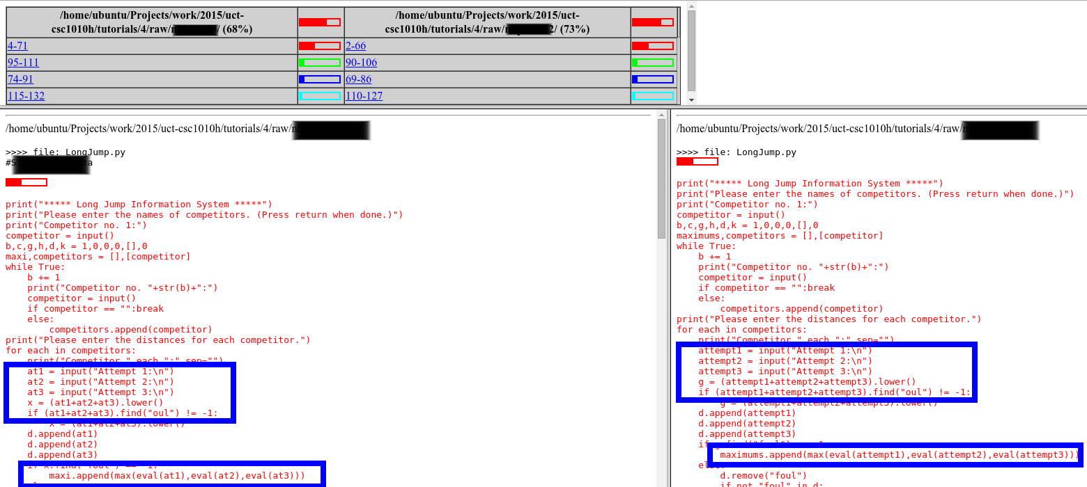
Cheating, Collusion, Plagiarism
“Helping” others is NOT OK!
MOSS
http://lightonphiri.org/wp-content/uploads/2015/09/moss_sample-initial_result-masked-021.png

Slide 31
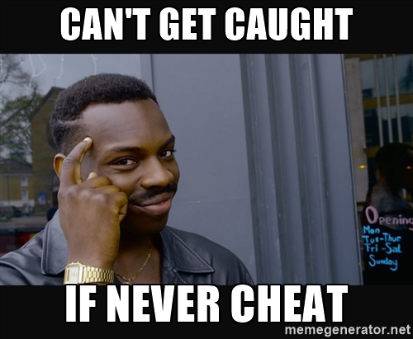

Slide 32
Student responsibilities
Responsibilities
Be regular to the weekly lecture.
Catch up missed lectures promptly through recordings on MULO.
Attendance to labs and tutes are important
Do not leave the assessed lab before your lab demonstrator has marked your assignment.
Prepare during self-study (nominally 8 hours/week -- more is better).
This subject is best understood practically. So, assimilating various concepts and practicing them (a lot!) is the key to success here.
Etiquette
No noise and distractions during the lectures
Turn your mobile devices to silent mode.

Slide 33
FIT2004: Programming Competition
Contest Format
Individual contest requiring you to write program to solve algorithmic problems
Two rounds. Tentative schedule:
Round 1: Week 4
Round 2: Week 8
3-6 problems in each round; each round will accept submissions for 2-3 weeks
Solutions will be automatically marked by an online judging system
Your score is the number of problems you solve
Contestants will be ranked according to their scores, and ties will be broken based on penalty (explained below)
Each incorrect submission carries a penalty. But the penalty is only applied if you finally solve the problem (e.g., say you solve problem #1 in 3 attempts and you have 3 failed attempts for problem #2 which you were unable to solve. Your score will be 1 and penalty will be 2 failed attempts on problem #1.)
Registration: to be open in week 3 (keep an eye on Moodle)
Prizes: Medal + (Certificates for top-5 contestants)
Practice: www.codeforces.com, https://uva.onlinejudge.org/

Slide 34
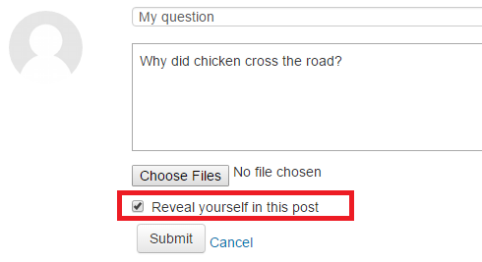
Anonymous Moodle Forum
The identity of a user is not visible to other users (including lectures)
Note: In case of appropriate usage, lecturers can still identify users by looking at logs
Rules (in addition to the rules for traditional non-anonymous forum)
Do not post hints/solutions to the assignments and workshop questions until one week after the due date
You can reveal your identity if you like

Slide 35
Kahoot!
Let’s try Kahoot!
One Kahoot round during each lecture
Will cover questions from previous week’s content
Winner will get a chocolate
or simply a “well done” if I forget to bring one :P

Slide 36
Anonymous surveys
Throughout the semester, I will send 2-3 anonymous surveys to get your feedback on things that can be improved in this unit
Please do fill these surveys (will take < 5 mins)

Slide 37
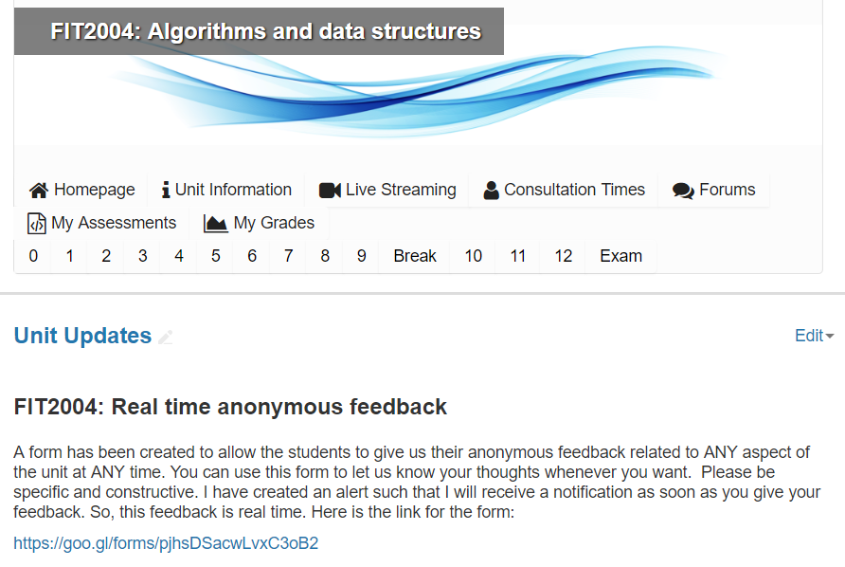
Real-time anonymous feedback
Google form to submit anonymous feedback any time
I receive a notification as soon as feedback is submitted
Please submit only constructive and actionable feedback

Slide 38

Short break

Slide 39
Part 2: Outline
Proving Correctness of Algorithms
Finding Minimum
Binary Search
Complexity Analysis (Recap)
Solving Recurrence Relations

Slide 40
Algorithmic Analysis
In algorithmic analysis, one is interested in (at least) two things:
An algorithm's correctness.
The amount of resources used by the algorithm
In this lecture we will see how to prove correctness.
Next week, we will analyse the resources used by the algorithm aka complexity analysis.

Slide 41

Consequences of errors
Explosion of unmanned Ariane 5 rocket in 1996
Exploded within 40 seconds after launch
Horizontal velocity incorrectly computed
Loss ~$7 Billion dollars

Slide 42

Consequences of errors
American Patriot Missile battery in Saudi Arabia failed to intercept an incoming Iraqi Scud Missile
Killed 28 US soldiers
Incorrect computation of the time since boot

Slide 43
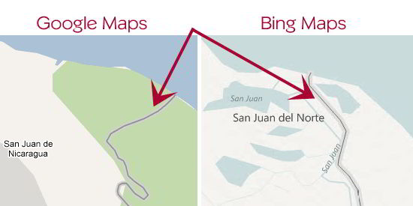
Consequences of errors
Incorrect maps almost started a war between Costa Rica and Nicaragua

Slide 44
Proving correctness of algorithms
Commonly, we write programs and then test them.
However, testing can only show that a program is wrong.
It cannot guarantee that it is always correct!
It may give correct results for 1 Billion test cases but may still be incorrect …
[Logic], on the other hand, can prove that a program is always correct. This is usually achieved in two parts:
Show that the program always terminates, and
Show that a program produces correct results when it terminates

Slide 45
Part 2: Outline
Proving Correctness of Algorithms
Finding Minimum
Binary Search
Complexity Analysis (Recap)
Solving Recurrence Relations

Slide 46
Finding minimum value
//Find minimum value in an unsorted array of N>0 elements
min = array[1]//in this unit, we assume index starts at 1
index = 2
while index <= N
if array[index] < min
min = array[index]
index = index + 1
return min

Slide 47
Does it always terminate?
//Find minimum value in an unsorted array of N>0 elements
min = array[1]
index = 2
while index <= N
if array[index] < min
min = array[index]
index = index + 1
return min

Slide 48
Correct result at termination?
//Find minimum value in an unsorted array of N>0 elements
min = array[1]
index = 2
while index <= N
if array[index] < min
min = array[index]
index = index + 1
return min

Slide 49
Correctness using Loop Invariant
//A Loop Invariant (LI) is a property that is true in each iteration
min = array[1]
index = 2
//LI: min equals the minimum value in array[1 … index - 1]
while index <= N
//LI: min equals the minimum value in array[1 … index-1]
if array[index] < min
min = array[index]
//min equals the minimum value in array[1 … index]
index = index + 1
//LI: min equals the minimum value in array[1 … index-1]
// and index = N + 1; thus min is min value in array [1 … N]
return min

Slide 50
Part 2: Outline
Proving Correctness of Algorithms
Finding Minimum
Binary Search
Complexity Analysis (Recap)
Solving Recurrence Relations

Slide 51
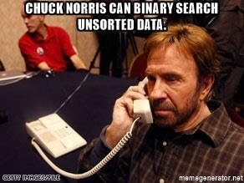
Binary Search revisited
5 | 10 | 15 | 20 | 25 | 30 | 35 | 40 | 45 | 50
1 | 2 | 3 | 4 | 5 | 6 | 7 | 8 | 9 | 10 | 11
lo
mid
mid
mid
hi
Binary search 20 in a sorted array
Since 20 < array[mid],
Search from lo to mid (e.g., move hi to mid)
Since 20 > array[mid]
Search from mid to hi (e.g., move lo to mid)
…

Slide 52
Algorithm for Binary Search
lo = 1//we are assuming indices range is 1 to N inclusive
hi = N + 1
while ( lo < hi )
mid = floor( (lo+hi)/2 )
if key >= array[mid]
lo=mid
else
hi=mid
if N > 0 and array[lo] == key
print(key found at index lo)
else
print(key not found)
Is this algorithm correct?
To prove correctness, we need to show that
it always terminates, and
it returns correct result when it terminates

Slide 53
Does this algorithm always terminate?
lo = 1
hi = N+1
while ( lo < hi )
mid = floor( (lo+hi)/2 )
if key >= array[mid]
lo=mid
else
hi=mid
if N>0 and array[lo] == key
print(key found at index lo)
else
print(key not found)
Enter your answers in MARS
Let us try to fix this
This algorithm may never terminate in some cases
mid
5 | 10 | 15 | 20 | 25
1 | 2 | 3 | 4 | 5
lo
hi
Key = 13

Slide 54
Does it always terminate?
lo = 1//we are assuming indices range is 1 to N inclusive
hi = N + 1
while ( lo < hi - 1 )
mid = floor( (lo+hi)/2 )
if key >= array[mid]
lo=mid
else
hi=mid
if N > 0 and array[lo] == key
print(key found at index lo)
else
print(key not found)
Proof that it always terminates
lo < hi – 1implies that the difference between lo and hi is always at least 2
Therefore, lo < mid < hi.
Hence, the search space always shrinks (e.g., lo and hi get closer after every iteration of the while loop until lo ≥ hi – 1 in which case the algorithm terminates)
mid
5 | 10 | 15 | 20 | 25
1 | 2 | 3 | 4 | 5
lo
hi
Key = 13

Slide 55
Correctness using Loop Invariant
lo = 1
hi = N + 1
// LI: key in array[1 … N] if and only if (iff) key in array[lo … hi - 1]
while ( lo < hi - 1 )
// LI: key in array[1 … N] iff key in array[lo … hi-1]
mid = floor( (lo+hi)/2 )
if key >= array[mid]
// key in array[1 … N] iff key in array[mid … hi-1]
lo=mid
// LI: key in array[1 … N] iff key in array[lo … hi-1]
else
// key in array[1 … N] iff key in array[lo … mid-1]
hi=mid
// LI: key in array[1 … N] iff key in array[lo … hi-1]
// LI: key in array[1 … N] iff key in array[lo … hi-1]

Slide 56
Correctness using Loop Invariant
// LI: key in array[1 … N] if and only if (iff) key in array[lo … hi - 1]
while ( lo < hi - 1 )
mid = floor( (lo+hi)/2 )
if key >= array[mid]
lo=mid
else
hi=mid
// LI: key in array[1 … N] iff key in array[lo … hi-1]
// lo ≥ hi – 1 → lo + 1 ≥ hi ---- (A)
// lo < hi → lo + 1 ≤ hi ---- (B)
// From (A) and (B): lo + 1 = hi → lo = hi - 1
// Hence, key in array[1 … N] iff key in array[lo … lo]; (Proof Complete)
if N > 0 and array[lo] == key
print(key found at index lo)
else
print(key not found)
Note: lo < hi when loop terminates, because
lo < mid < hi in each iteration and
we update either lo to be mid or hi to be mid

Slide 57
Part 2: Outline
Proving Correctness of Algorithms
Finding Minimum
Binary Search
Complexity Analysis (Recap)
Solving Recurrence Relations

Slide 58
Complexity Analysis
Time complexity
The amount of time taken by an algorithm to run as a function of the input size
Space complexity
The amount of space taken by an algorithm to run as a function of the input size
Worst-case complexity
Best-case complexity
Average-case complexity

Slide 59
Recap from FIT1045: Complexity
How to compute time complexity?
Count the number of steps taken by the algorithm as a function of input size, e.g., 2N² +10N + 100
The big-O notation of this function is its complexity, e.g., 2N² +10N + 100 → O(N²)

Slide 60
Recap from FIT1045: Big-O notation
Let N be the number of days
# of rabbits → 2N²
# of goats → 10N
# of lions → 100
#total population → 2N² +10N + 100
The population grows mainly because of growth rate of rabbits
For large values of N, # of other animals is insignificant as compared to the # of rabbits
We can say population grows in “Order of rabbits’ growth”
i.e., population growth is O(N²)
N | rabbits | goats | lions | Total
1 | 2 | 10 | 100 | 112
2 | 8 | 20 | 100 | 128
3 | 18 | 30 | 100 | 148
4 | 32 | 40 | 100 | 172
5 | 50 | 50 | 100 | 200
6 | 72 | 60 | 100 | 232
7 | 98 | 70 | 100 | 268
8 | 128 | 80 | 100 | 308
9 | 162 | 90 | 100 | 352
10 | 200 | 100 | 100 | 400
11 | 242 | 110 | 100 | 452
12 | 288 | 120 | 100 | 508
13 | 338 | 130 | 100 | 568
14 | 392 | 140 | 100 | 632
15 | 450 | 150 | 100 | 700
16 | 512 | 160 | 100 | 772
17 | 578 | 170 | 100 | 848
1000 | 2000000 | 10000 | 100 | 2010100

Slide 61
Recap from FIT1045: Big-O notation
Let N be the number of days
# of rabbits → 2N²
# of goats → 10N
# of lions → 100
#total → 2N²+10N+100

Slide 62
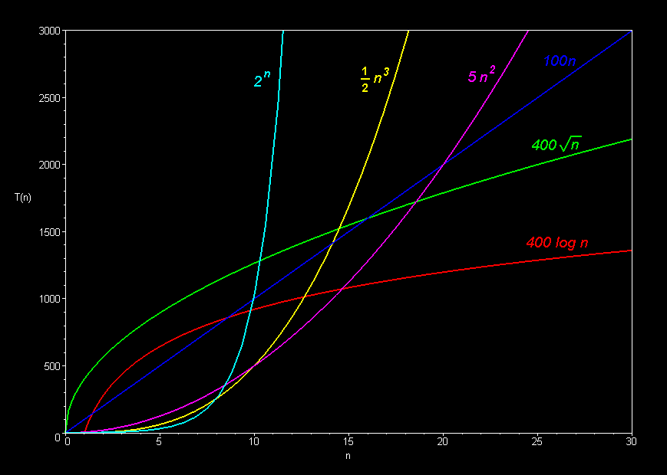
Recap from FIT1045: Big-O notation
Typically, we use the following simplification rules
If function is a product of several terms, any constants that do not depend on N can be ignored
If function is a sum of several terms, if there is one with the largest growth rate, it can be kept and others can be omitted
E.g.,
12 N² + 4 N³
→ O(N³)
12 N² + 3 N log(N)
➔ O(N²)
8N⁴ + N² log(N) + 12000
➔ O(N⁴)
1000 + 5000
➔ O(N⁰)➔ O(1)

Slide 63

What is the complexity of an algorithm in Big-O notation that runs in 30N log (N²) + 10 log N + 8N?
O(N log N)
O(N log (N²))
O(N log (N²) + N + log N)
Option D because

Slide 64
Part 2: Outline
Proving Correctness of Algorithms
Finding Minimum
Binary Search
Complexity Analysis (Recap)
Solving Recurrence Relations

Slide 65
Recurrence Relations
A recurrence relation is an equation that recursively defines a sequence of values, and one or more initial terms are given.
E.g.,
T(1) = b
T(N) = T(N-1) + c
Complexity of recursive algorithms can be analysed by writing its recurrence relation and then solving it

Slide 66
Solving Recurrence Relations
// Compute Nth power of x
power(x,N)
{
if (N==0)
return 1
if (N==1)
return x
else
return x * power(x, N–1)
}
Our goal is to reduce this term to T(1)
Time Complexity
Cost when N = 1: T(1) = b (b&c are constant)
Cost for general case: T(N) = T(N-1) + c (A)
Cost for N-1: T(N-1) = T(N-2) + c
Replacing T(N-1) in (A)
T(N) = (T(N-2) + c) + c = T(N-2) + 2*c (B)
Cost for N-2: T(N-2) = T(N-3) + c
Replacing T(N-2) in (B)
T(N) = T(N-3) + c+c+c = T(N-3) + 3*c
Do you see the pattern?
T(N) = T(N-k) + k*c
Find the value of k such that N-k = 1 → k = N-1
T(N) = T(N-(N-1)) + (N-1)*c = T(1) + (N-1)*c
T(N) = b + (N-1)*c = c*N + b - c
Hence, the complexity is O(N)

Slide 67
Solving Recurrence Relations
// Compute Nth power x
power2(x,N)
{
if (N==0)
return 1
if (N==1)
return x
if (N is even)
return power2( x * x, N/2)
else
return power2( x * x, N/2 ) * x
}
Time Complexity
Cost when N = 1: T(1) = b (b&c are constant)
Cost for general case: T(N) = T(N/2) + c (A)
Cost for N/2: T(N/2) = T(N/4) + c
Replacing T(N/2) in (A)
T(N) = T(N/4) + c + c = T(N/4) + 2*c (B)
Cost for N/4: T(N/4) = T(N/8) + c
Replacing T(N/4) in (B)
T(N) = T(N/8) + c+c+c = T(N/8) + 3*c
Do you see the pattern?
T(N) = T(N/2^{k}) + k*c
Find the value of k such that N/2^{k} = 1 → k = log₂ N
T(N) = T(N/2^{log N}) + c*log N = T(1) + c* log₂ N
T(N) = b + c* log₂ N
Hence, the complexity is O(log N)

Slide 68
Logarithmic complexity
Recurrence relation:
T(N) = T(N/2) + c
T(1) = b
Solution:
O(log N)

Slide 69
Linear Complexity
Recurrence relation:
T(N) = T(N-1) + c
T(1) = b
Solution:
O(N)

Slide 70
Linearithmic complexity
Recurrence relation:
T(N) = 2*T(N/2) + c*N
T(1) = b
Solution:
O(N log N)

Slide 71
Quadratic complexity
Recurrence relation:
T(N) = T(N-1) + c*N
T(1) = b
Solution:
O(N²)

Slide 72
Exponential complexity
Recurrence relation:
T(N) = 2*T(N-1) + c
T(0) = b
Solution:
O(2^{N})

Slide 73
Revision: Proof by induction
2 steps
Prove the base case, e.g., for the first state
Assume the proof holds for a state k. Show that it also holds for the next state k+1.
Theorem
Let S(N) be the sum of the integers from 1 to N
Prove that S(N) = N(N+1)/2
Step 1: Base Case: N = 1
S(1) = 1 and N(N+1)/2 is 1 for N=1
Step 2: Inductive step
Assume it holds for a positive integer k
S(k) = k(k+1)/2
Show that S(k+1) = (k+1)(k+2)/2
continued on next slide…

Slide 74
Revision: Proof by induction
Theorem
Let S(N) be the sum of the integers from 1 to N
Prove that S(N) = N(N+1)/2
Step 2: Inductive step
Assume it holds for a positive integer k
S(k) = k(k+1)/2
Show that S(k+1) = (k+1)(k+2)/2
S(k+1) = 1 + 2 + 3 + … + k+1
S(k+1) = 1 + 2 + 3 + … + k + k+1
S(k+1) = k(k+1)/2 + k+1
S(k+1) = (k+1)(k+2)/2
For more details, watch it on Khan Academy (click here)

Slide 75
Concluding Remarks
Summary
This unit demands your efforts from week 1
Testing cannot guarantee correctness; Requires logical reasoning to formally prove correctness
Coming Up Next
Analysis of algorithms
Non-comparison based sorting (Counting Sort, Radix Sort) – related to Assignment 1
IMPORTANT: Preparation required before the next lecture
Revise computational complexity covered in earlier units (FIT1045, FIT1008). You may also want to watch videos or read other online resources
Complete Tutorial 1 (at your own time)
Revise abstract data types, loop invariants, binary search, insertion sort, and selection sort

